Slide 1
Chapter 5
Database Security

Slide 2
OVERVIEW OF DATABASE SECURITY
Privacy – Ethical and legal rights that individuals have with regard to control over the dissemination and user of their personal information.
Database security – Protection of information contained in the database against unauthorized access, modification or destruction.
Database integrity – Mechanism that is applied to ensure that the data in the database is correct and consistent.

Slide 3
…CON’T
A good database security management system has:
data independence, shared access, minimal redundancy, data consistency, and data integrity
A good database security management system also has the following characteristics:
Privacy signifies that an unauthorized user cannot disclose data
Integrity ensures that an unauthorized user cannot modify data.
Availability ensures that data be made available to the authorized user unfailingly
Copyright ensures the native rights of individuals as a creator of information.
Validity ensures activities to be accountable by law.

Slide 4
…CON’T
Database system can effectively prevent accidental security and integrity threats from:
System error,
Improper authorization and
Concurrent usage anomalies.
The levels of security protection, it may start from organization & administrative security, physical & personnel security, communication security and Information systems security.
Database security and integrity is about protecting the database from being inconsistent and being disrupted.
We can also call it database misuse.
Database misuse could be Intentional or Accidental, where accidental misuse is easier to cope with than intentional misuse.

Slide 5
…CON’T
Accidental inconsistency could occur due to:
System crash during transaction processing
Anomalies due to concurrent access
Anomalies due to redundancy
Logical errors
Intentional misuse could be:
Unauthorized reading of data
Unauthorized modification of data or
Unauthorized destruction of data
Most systems implement good Database Integrity to protect the system from accidental misuse.

Slide 6
Levels of Security Measures
Security measures can be implemented at several levels and for different components of the system.
These levels are:
Physical Level: concerned with securing the site containing the computer system.
The backup systems should also be physically protected from access except for authorized users.
Human Level: concerned with authorization of database users for access the content at different levels and privileges.
Operating System: concerned with the weakness and strength of the operating system security on data files.
This also includes protection of data in primary and secondary memory from unauthorized access.
Database System: concerned with data access limit enforced by the database system.
Access limit like password
Application Level: Since almost all database systems allow remote access through terminals or networks, software-level security with the network software is as important as physical security, both on the Internet and networks private to an enterprise.

Slide 7
…CON’T
We can have different levels of security and authorization on data objects and users, who access which data is a policy matter rather than technical.
These policies
should be known by the system: should be encoded in the system.
should be remembered: should be saved somewhere (the catalogue)

Slide 8
…CON’T
Database Integrity constraints contribute to maintaining a secure database system by preventing data from becoming invalid and hence giving misleading or incorrect results.
Domain Integrity means that each column in any table will have set of allowed values and can not assume any value other than the one specified in the domain.
Entity Integrity means that in each table the primary key (which may be composite) satisfies both of two conditions:
That the primary key is unique within the table and
That the primary key column(s) contains no null values.
Referential Integrity means that the RDBMS must be set up so as to take appropriate actions to spread a change—in one table—from that table to the other tables where the change must also occur.

Slide 9
Security Issues and general considerations
Legal, ethical and social issues regarding the right to access information
Physical control issues regarding how to keep the database physically secured.
Policy issues regarding privacy of individual level at enterprise and national level
Operational consideration on the techniques used (password, etc) to access and manipulate the database
System level security including operating system and hardware control
The designer and the administrator of a database should first identify the possible threat that might be faced by the system in order to take counter measures.
Threat may be any situation or event, whether intentional or accidental, that may adversely affect a system and consequently the organization.

Slide 10
…CON’T
A threat may be caused by a situation or event involving a person, action, or circumstance that is likely to bring harm to an organization
The harm to an organization may be tangible or intangible
Tangible – loss of hardware, software, or data
Intangible – loss of credibility or client confidence

Slide 11
…CON’T
Examples of threats:
Using another persons’ means of access
Unauthorized amendment/modification or copying of data
Program alteration(making different)
Inadequate policies and procedures that allow a mix of confidential and normal out put
Wire-tapping
Ilegal entry by hacker
Blackmail
Theft of data, programs, and equipment
Failure of security mechanisms, giving greater access than normal
Staff shortages or strikes
Inadequate staff training
Viewing and disclosing unauthorized data
Electronic interference and radiation
Data corruption owing to power loss or surge
Fire (electrical fault, lightning strike, arson), flood, bomb
Physical damage to equipment
Breaking cables or disconnection of cables
Introduction of viruses

Slide 12
Countermeasures: Computer Based Controls
The following are computer-based security controls for a multi-user environment:
Authorization
The granting of a right or privilege that enables a subject to have legal access to a system or a system’s object.
Authorization controls can be built into the software, and govern not only what system or object a specified user can access, but also what the user may do with it
Authorization controls are sometimes referred to as access controls
The process of authorization involves authentication of subjects (i.e. a user or program) requesting access to objects (i.e. a database table, view, procedure, trigger, or any other object that can be created within the system)

Slide 13
…CON’T
Views
A view is the dynamic result of one or more relational operations on the base relations to produce another relation.
A view is a virtual relation that does not actually exist in the database, but is produced upon request by a particular user
The view mechanism provides a powerful and flexible security mechanism by hiding parts of the database from certain users
Using a view is more restrictive than simply having certain privileges granted to a user on the base relation(s).

Slide 14
…CON’T
Backup and recovery
Backup is the process of periodically taking a copy of the database and log file (and possibly programs) on to offline storage media.
Database recovery is the process of restoring the database to a correct state in the event of a failure.
Journaling is the process of keeping and maintaining a log file (or journal) of all changes made to the database to enable recovery to be undertaken effectively in the event of a failure.
The advantage of journaling is that, in the event of a failure, the database can be recovered to its last known consistent state using a backup copy of the database and the information contained in the log file.
If no journaling is enabled on a failed system, the only means of recovery is to restore the database using the latest backup version of the database

Slide 15
…CON’T
Integrity
Integrity constraints contribute to maintaining a secure database system by preventing data from becoming invalid and hence giving misleading or incorrect results.
Domain Integrity: setting the allowed set of values
Entity integrity: demanding Primary key values not to assume a NULL value.
Referential integrity: enforcing Foreign Key values to have a value that already exist in the corresponding Candidate Key attribute(s) or be NULL.

Slide 16
Encryption
Encryption is used to protect information stored at a particular site or transmitted between sites from being accessed by unauthorized users.
Encryption is the encoding of the data by a special algorithm that renders the data unreadable by any program without the decryption key.
It is not possible for encrypted data to be read unless the reader knows how to decipher/decrypt the encrypted data.
The DBMS can access data after decoding it, although there is a degradation in performance because of the time taken to decode it.
Encryption also protects data transmitted over communication lines.

Slide 17
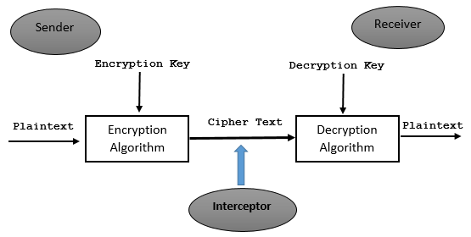
…CON’T
To transmit data securely over insecure networks requires the use of a Cryptosystem, which includes:
An encryption key to encrypt the data (plaintext)
An encryption algorithm that, with the encryption key, transforms the plaintext into ciphertext
A decryption key to decrypt the ciphertext
A decryption algorithm that, with the decryption key, transforms the ciphertext back into plaintext

Slide 18
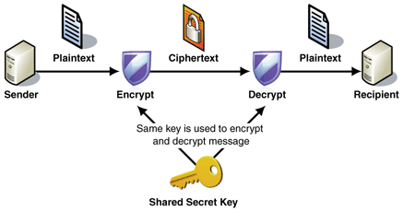
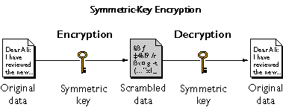
Types of Cryptosystems
Cryptosystems can be categorized into two:
Symmetric encryption – uses the same key for both encryption and decryption and relies on safe communication lines for exchanging the key.

Slide 19
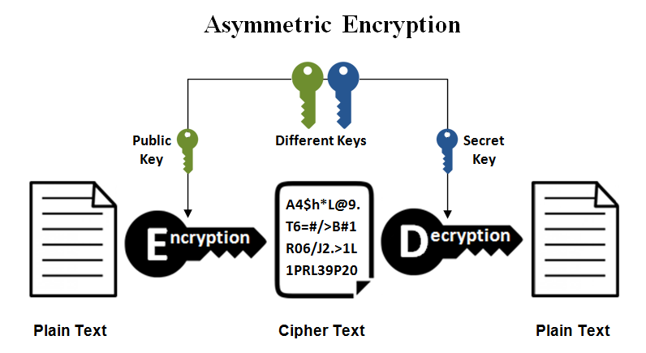
…CON’T
2. Asymmetric encryption – uses different keys for encryption and decryption e.g. RSA(Rivest–Shamir–Adleman)
Generally, symmetric algorithms are much faster to execute on a computer than those that are asymmetric.
In the contrary, asymmetric algorithms are more secure than symmetric algorithms.

Slide 20
RAID technology (Redundant Array of Independent Disks)
The main hardware components that should be fault-tolerant include disk drives, disk controllers, CPU, power supplies, and cooling fans.
Disk drives are the most vulnerable(attackable) components with the shortest times between failures of any of the hardware components.
RAID works on having a large disk array comprising an arrangement of several independent disks that are organized to improve reliability and at same time increase performance
Performance is increased through data striping

Slide 21
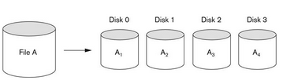
…CON’T
Data striping – the data is segmented into equal size partitions (the striping unit) which are transparently distributed across multiple disks.
Data striping stores data across multiple disks
Figure: Data striping File A striped across four disks

Slide 22
Security at different Levels of Data
Almost all RDBMSs provide security at different levels and formats of data.
This includes:-
Relation Level: permission to have access to a specific relation.
View Level: permission to data included in the view and not in the named relations
Hybrid (Relation/View): the case where only part of a single relation is made available to users through View.
Any database access request will have the following three major components:-
Requested Operation: what kind of operation is requested by a specific query?
Requested Object: on which resource or data of the database is the operation required to be applied?
Requesting User: who is the user requesting the operation on the specified object?

Slide 23
Authentication
All users of the database will have different access levels and permission for different data objects.
Is the process of checking whether the user is the one with the privilege for the access level.
Each user is given a unique identifier, which is used by the operating system to determine who they are.
Thus the system will check whether the user with a specific username and password is trying to use the resource.
Associated with each identifier is a password, chosen by the user and known to the operation system, which must be supplied to enable the operating system to authenticate who the user claims to be.

Slide 24
Authorization/Privilege
Authorization refers to the process that determines the mode in which a particular (previously authenticated) client is allowed to access a specific resource controlled by a server.
Authorization is implemented by using Views.
Views are unnamed relations containing part of one or more base relations creating a customized/personalized view for different users.

Slide 25
…CON’T
Forms of user authorization
There are different forms of user authorization on the resource of the database.
These forms are privileges on what operations are allowed on a specific data object.
User authorization on the data/extension
Read Authorization: the user with this privilege is allowed only to read the content of the data object.
Insert Authorization: the user with this privilege is allowed only to insert new records or items to the data object.
Update Authorization: users with this privilege are allowed to modify content of attributes but are not authorized to delete the records.
Delete Authorization: users with this privilege are only allowed to delete a record and not anything else.
Different users, depending on the power of the user, can have one or the combination of the above forms of authorization on different data objects.
Notes:
? :,mp’[\45

Slide 26
…CON’T
User authorization on the database schema
Index Authorization: deals with permission to create as well as delete an index table for relation.
Resource Authorization: deals with permission to add/create a new relation in the database.
Alteration Authorization: deals with permission to add as well as delete attribute.
Drop Authorization: deals with permission to delete and existing relation.

Slide 27
Role of DBA in Database Security
The database administrator is responsible to make the database to be as secure as possible and have the most powerful privilege than every other user.
The DBA provides capability for database users while accessing the content of the database.
The major responsibilities of DBA in relation to authorization of users are:
Account Creation: involves creating different accounts for different users as well as user groups.
Security Level Assignment: involves in assigning different users at different categories of access levels.
Privilege Grant: involves giving different levels of privileges for different users and user groups.
Privilege Revocation: involves denying or canceling previously granted privileges for users due to various reasons.
Account Deletion: involves in deleting an existing account of users or user groups. Is similar with denying all privileges of users on the database.

Slide 28
Approaches to Database Security
There are two broader approaches to database security mechanisms:
1) Discretionary security mechanisms
Grant different privileges to different users and user groups on various data objects
The privilege is to access different data objects
The mode of the privilege could be:
Read,
Insert,
Delete,
Update files, records or fields.
Is more flexible

Slide 29
…CON’T
2) Mandatory security mechanisms
Enforce multilevel security
classifying data and users into various security classes (or levels) and implementing the appropriate security policy of the organization.
Each data object will have certain classification level
Each user is given certain clearance level
Only users who can pass the clearance level can access the data object
Is comparatively not-flexible/rigid
The ability to classify user into a hierarchy of groups provide a powerful tool for administering large systems with thousands of users and objects.
A database system can support one or both of the security mechanisms to protect the data.

Slide 30
Statistical Database Security
Statistical databases contain information about individuals which may not be permitted to be seen by others as individual records.
Such databases may contain information about various populations.
Example: Medical Records, Personal Data like address, salary, etc
Such kind of databases should have special security mechanisms so that confidential information about people will not be disclosed for many users.
Thus statistical databases should have additional security techniques which will protect the retrieval of individual records.
Only queries with statistical aggregate functions like Average, Sum, Min, Max, Standard Deviation, Mid, Count, etc should be executed.

Slide 31
END

